Slide 1
Finding best place to open Mughlai Restaurant in Kolkata
USING K-MEANS CLUSTERING AND FOUR-SQUARE API

Slide 2
Everyone loves Biriyani and Mughlai Cuisine of Kolkata
Food feuds — like family vendettas — carry on. An enduring one is the war between food lovers of Delhi and Kolkata. 'Where is the Mughlai — as Muslim food is called — better?' I am often asked. With some regret I must say that it is Kolkata. Delhi has a few old and iconic restaurants that offer everything from biryani and korma to kababs and ishtus, no doubt, but Kolkata has many more eateries where you get the best of dishes. I still dream of the chaap that I ate at Royal, a bustling restaurant in the heart of the city. There are also a host of small and big restaurants which serve the most delicious Kolkata biryani that you can ever imagine.
…….. Rahul Verma (Delhi vs Kolkata: The city with the better Mughlai food : The Hindu)

Slide 3
Outline
Introduction
Business Problem and Targeted Audience
Data and Its Sources
Methodology
Results
Discussion
Conclusion

Slide 4
Introduction
Somewhere between Rossogollas and lip-smacking fish preparations, many rich Bengali delicacies go unnoticed. And one such delicacy is the Kolkata Biryani.
One can also blame the greater popularity of its southern counterpart - Hyderabadi Biryani, which might have for long prevented the Kolkata Biryani to flourish in all its glory.
But Kolkata Biryani is slowly working its way out of the canals of the City of Joy and gaining the due recognition it has long deserved.

Slide 5
Business Problem and Targeted Audiance
The aim of this project is to find out the best place in Kolkata to open a Mughlai Restaurant.
In this project, leveraging venue data from Foursquare's 'Places AP' and 'k-means clustering' unsupervised machine learning algorithm, we will try to answer the question if someone want to open a Mughlai Restaurant in Kolkata which is the best for it.
So anyone want to open a new Mughlai Restaurant in Kolkata and do not know where to open the shop to make profit, this project should attract their attention.

Slide 6
Data and its Sources
For this project, we need to have the below data:
The List of the Neighborhoods in Kolkata, India.
The Longitude and Latitude coordinates of the Kolkata Neighborhoods
Data Sources:
Wikipedia using web scrapping.
The latitude and longitude coordinates using Python Geocoder Package.
Foursquare API.

Slide 7
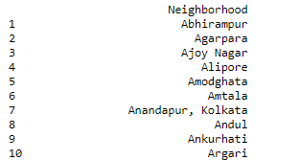
Methodology
Fetching neighborhood's details of Kolkata from Wikipedia using Web Scrapping:
Using BeautifulSoup and request we have extracted the neighborhood's details of Kolkata city.

Slide 8
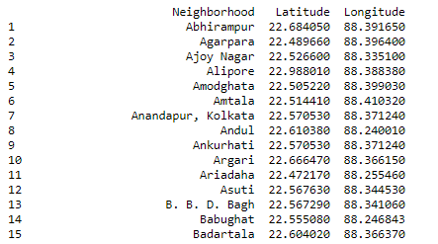
Methodology
Using geocoder package, we are able to extract the details of geographical co-ordinates of each location and created a dataframe.

Slide 9
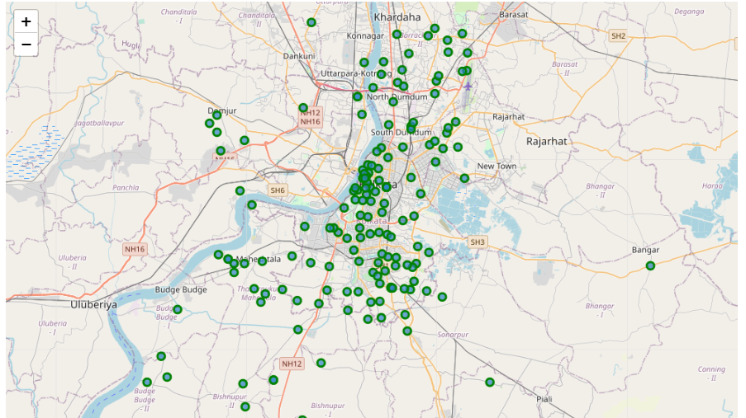
Methodology
Visualizing Neighborhoods of Kolkata:
Using folium, we have visualized the map of Kolkata city and its neighborhoods.

Slide 10
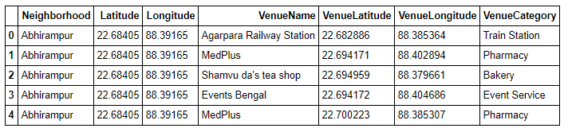
Methodology
Exploring the Neighborhoods of Kolkata using Foursquare API
Using Foursquare API we are able to extract a dataframe which has which has 4285 observations and 7 features. We are able to extract 147 unique venue categories like Bakery, Pharmacy and as well as Mughlai Restaurant.

Slide 11
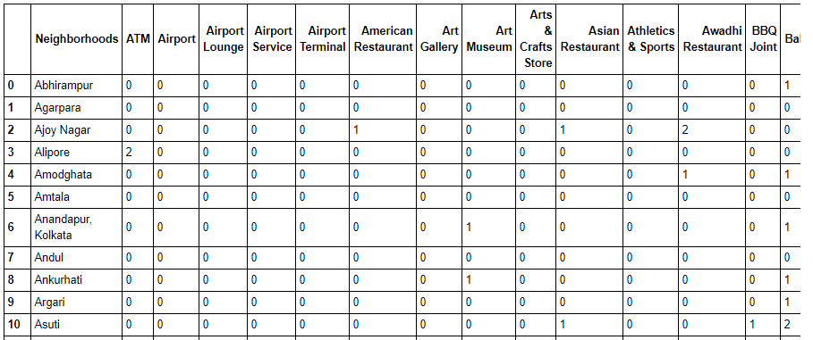
Methodology
Analysing Neighbourhoods
After applying one-hot encoding we have managed to get 4285 observation and 148 features. By taking the sum of occurrence of each category we have grouped the rows of the neighborhoods and We have found there are 67 Mughlai restaurants in Kolkata which quite high for a Mughlai restaurant number in a city.

Slide 12
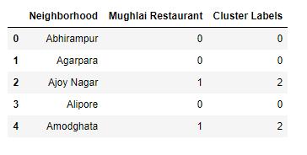
Methodology
Clustering Neighbourhoods
We have taken the number of clusters as 5 and applied clustering to segregate the neighborhoods and form different clusters to identify the clusters having lower number of Mughlai Restaurant.

Slide 13
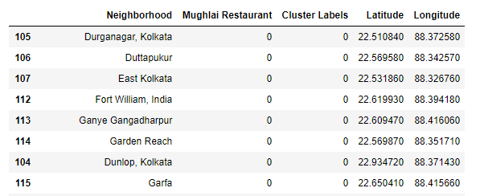
Methodology
We added the geographical data of each neighborhoods and sorted the dataframe using the cluster labels.

Slide 14
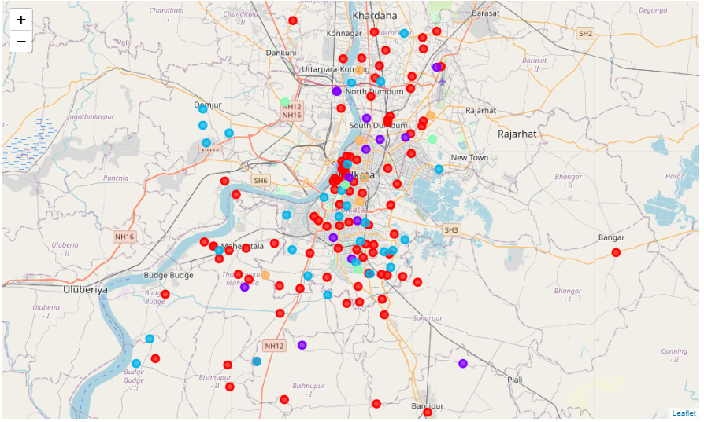
Methodology
We have visualized the clusters on the map of Kolkata and we can say that cluster zero has more occurrence than any other clusters.

Slide 15
Methodology
Ultimately, we have collected the results of our clustering.
The neighborhoods in cluster 0: 115
The neighborhoods in cluster 1: 15
The neighborhoods in cluster 2: 40
The neighborhoods in cluster 3: 4
The neighborhoods in cluster 4: 8

Slide 16
Results
From the result of the K-Means clustering we can cluster the neighborhoods into 5 clusters:
Cluster 0: It categorizes the neighborhoods which are having zero/ very low number of Mughlai Restaurant.
Cluster 1: It categorizes the neighborhoods which are having low number of Mughlai Restaurant.
Cluster 2: It categorizes the neighborhoods which are having moderate number of Mughlai Restaurant.
Cluster 3: It categorizes the neighborhoods which are having high number of Mughlai Restaurant.
Cluster 4: It categorizes the neighborhoods which are having very high number of Mughlai Restaurant.
We have extracted the length of each cluster and cluster 0 has the largest number of neighborhoods where the number of Mughlai Restaurant is very low to none.

Slide 17
Discussions
Cluster 1 and cluster 2 are also having neighborhoods with low to moderate number of Mughlai Restaurant but compare to Cluster 0 the number of neighborhoods are low. But we cannot discard those clusters as having lower number of Mughlai Restaurant the people of those neighborhoods have a taste of Mughlai. If we want, we can turn the favor towards us and make a profit by opening a Mughlai Restaurant there also.

Slide 18
Conclusion
Even though overall Kolkata has large number of Mughlai Restaurant, cluster 0 having lower number of Mughlai Restaurant shows a great opportunity to build a successful business and make a profit out of it. As the trend is going, the hunger for Mughlai cuisine is keep increasing among the people of the city Kolkata. So, if anyone wants taking the advantage of lower number of Mughlai Restaurant in cluster 0 can set up a Mughlai Restaurant.
Just keep in mind that we have used the number or the occurrence of Mughlai restaurant and analyzed and categorized the data to come up with the results. There are other factors like cost of the project, population of the area, the average income of the population, type of shop like take away or in house sitting, can be added to more precise prediction.

Slide 19
Important Links
Wikipedia : https://en.wikipedia.org/wiki/Category:Neighbourhoods_in_Kolkata
Four Square API: https://foursquare.com/developers/apps
Geocoder: https://pypi.org/project/geocoder/
Folium: https://python-visualization.github.io/folium/

Slide 20
Thank you…

